Slide 1
SMART AND SUSTAINABLE GARMENT
Student 1 (202FT107 KAVISHNA R)
Student 2 (202FT110 MONIKA T)
Student 3 (202FT106 KALPANA M)
Student 4 (202FT118 SARASWATHI B)
Under guidance of
Ms. SARANYA D.V ,
ASSISTANT PROFESSOR AND HEAD DEPARTMENT OF FASHION TECHNOLOGY,
BIT,
Sathy.

Slide 2
Abstract
A Smart garment with the combination of sustainable and vegan fabrics will have a great impact on the upcoming textile industry. Smart clothing products are essentially electronic devices designed to communicate with connected devices like smartphones and the wearer’s body. A sensible Sensing Garment-SSG is developed for watching body postures supported by FBG and Bend sensors. A FBG sensible belt is used primarily by embedding FBG sensors within a special silica gel and a connected sensible garment is stitched with flex sensors within garment surface. The sensible garment is used to monitor body postures at different joint positions of wearer. FBG sensors mounted at the joint positions of palm, wrist, and elbow will show affordable and protracted wavelength modifications for every step-by-step angle change. The bend sensors mounted within the SSG will exhibit linear rise because the increase of joint angles at the positions of palm, gliding joint and elbow. The measured knowledge from bend sensors show that the movement of a wearer can be successfully detected by SSG. Combination of the two technologies (FBG and Bend Sensors) can be used to investigate the modification of body postures arise from the various diseases like stroke and bone fracture. Sustainable textiles area utilised in fashion to address the growing awareness of however the textiles processes accustomed create covering impact the globe around us. Sometimes known as eco-friendly, these materials will be a mix of natural plant-based fibres like organic cotton, hemp, or bamboo. Vegan fibres and hemp fibres are used for the production of garment. It takes a lot less water and energy in the production of this super fabric as compared to other fabrics. Hemp has low carbon emissions and is capable of capturing carbon emissions from the atmosphere, that means it’s significantly higher for the atmosphere than cotton. Most commonly known attributes about hemp fibre are its exceptional tensile strength which is three times that of cotton. This project deals with posture monitoring smart garment by incorporating sustainable way of construction using vegan fibres.
KEYWORDS:
Fibre Bragg Grating, Bend sensor, Smart sensing garment, Body posture, sustainable and vegan fibres, eco – friendly.

Slide 3
Problem Statement Addressed
In neurological rehabilitation center where patients engage in training to practice arm-hand skills after stroke or spinal cord injury or because they suffer from chronic condition such as multiple sclerosis or cerebral palsy.
While interactive technology often provide appropriate training content in terms of the stimuli and feedback provided to patients, a challenge that characterizes many of these is that patients will engage in compensatory movements where they can achieve the task set to them by the rehabilitation technology, while moving alternative muscle groups than the ones that they wish to train.
Similarly for training patients with shoulder pain, a set of movements involving the upper extremities is given, but which require appropriate posture to be maintained during the training.
For these reasons it is important to create technology that will provide feedback to patients regarding their posture during training.

Slide 4
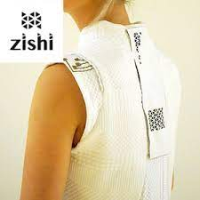
Existing Solution to the Problem Addressed
Zishi is a garment designed to support posture monitoring for the purposes of rehabilitation training. It has been designed with attention to presenting accurate and informative feedback to patients regarding their thoracic and shoulder posture as well as comfort, ease of use, wearability and aesthetics.
Zishi can be useful during rehabilitation training for a variety of patient groups.
Zishi consists of a garment integrated with smart textiles and wearable electronics.
It presents feedback as a vibration delivered through the garment to connected devices.

Slide 5
Proposed Solution to the Problem Addressed
Posture monitoring and correction technologies in our smart garment can support prevention and treatment of spinal pain.
It is made up of sustainable and vegan fabrics.
FBG sensors mounted at the joint positions of palm, wrist, and elbow will show affordable and protracted wavelength modifications for every step-by-step angle change.
Modular design is another feature of our garment as one set of sensor package can connect with any garment that embedded conductive fabric patterns. A tiny magnet has been placed under each of the small golden square fabric as the connection point.
It presents real-time feedback as a vibration delivered through the garment, visual and audio instructions through android-hand held device (smartphone or tablet).
The fabric used will be based on sustainable and vegan fibers .
This may have a great positive impact both for the wearer and the environment .

Slide 6
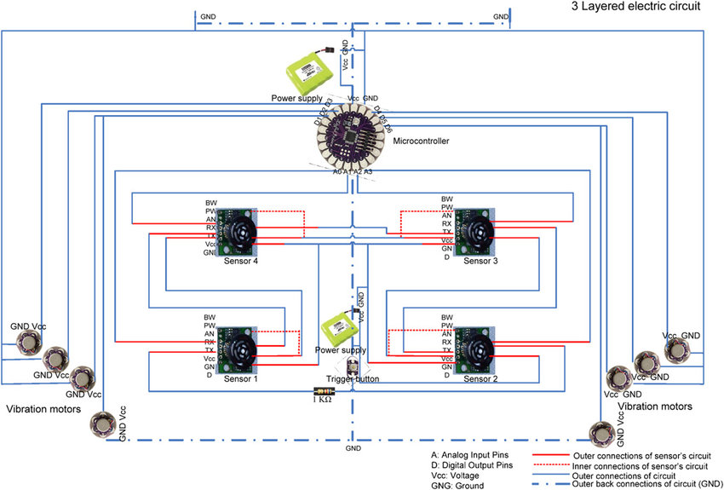
Block Diagram and/or Circuit Diagram

Slide 7
Effective utilization of the Modern Tool & Cloud
Body posture identification through Fiber Bragg grating (FBG) sensing medium has been extensively used for monitoring various engineering structures due to the rewards such as high sensitivity, the simplicity of application, great consistency, light mass, minor size, upright stability, and safe to electromagnetic interference.
FBG or Optical fibers based smart textile structures are now good solutions for posture monitoring and can also bring new trends positively in the field of healthcare monitoring. Through the growth of FBG and optical fiber-based smart textiles is getting vital popularity, the use of FBG sensors for posture monitoring of different joints positions is still limited .
The technique mentioned above have significant contributions to the wearable sensing technologies.

Slide 8
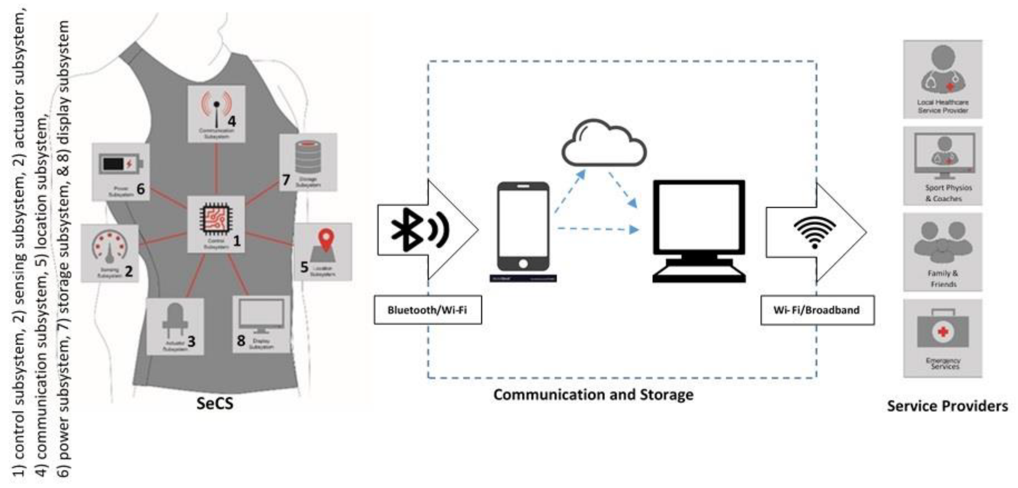
Technology stack

Slide 9
Use case
Detection of position change of spinal cord
Data processed using server
Processed data is sent to the mobile app through the module
Alert through app and analysed result is shown.

Slide 10
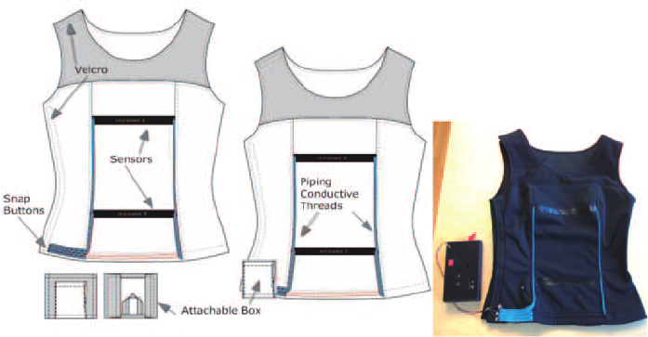
Prototype & Sample Output

Slide 11
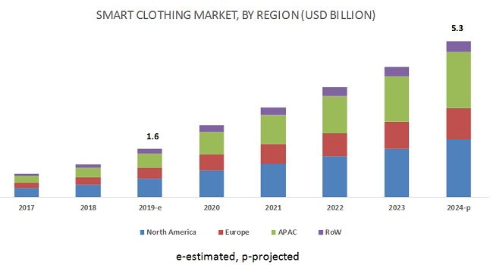
Analysis of Results & Discussions
It uses vegan fabric and sustainable materials which has positive effects on the environment.
It uses natural dyes which benefits the environment.
It presents real-time feedback as a vibration delivered through the garment, visual and audio instructions through android-hand held device (smartphone or tablet).
The overall smart clothing market is likely to grow from USD 1.6 billion in 2019 to USD 5.3 billion by 2024.
Patients affected by spinal cord disorders.
Aged people.
Sports persons are more likely to have the highest risk of catastrophic spinal injuries.

Slide 12
Cost Benefit Analysis (List of Components / Service Used)
S.No | Component Name | Specification (IC number or Range or Value) | Unit Cost | Total Cost
1. | Photocell E3JK-5DM1 DC12-24V | 4 | 750 | 3000
2. | FlexiForce A101 | 3 | 700 | 2100
3. | Garment construction | 1 | 400 | 400
4. | Manufacturing | - | - | 1000
 |  |  | Total cost | 6500

Slide 13
References
Ariponnammal, S. and Natarajan, S. (1994) “Transport Phonomena of SmSel – Xasx”, Pramana – Journal of Physics Vol.42, No.1, pp.421-425.
Barnard, R.W. and Kellogg, C. (1980), “Applications of Convolution Operators to Problems in Univalent Function Theory”, Michigan Mach, J., Vol.27, pp.81-94.
Shin, K.G. and Mckay, N.D. (1984), “Open Loop Minimum Time Control of Mechanical Manipulations and its Applications‟, Proc. Amer. Contr. Conf., San Diego, CA, pp. 1231-1236.

